Slide 1


<Sangwoo Kim>
<July 23rd 2022>

Slide 2

Outline
Executive Summary
Introduction
Methodology
Results
Conclusion
Appendix
All the links to the files described in this PowerPoint slide can be found here:
https://github.com/sangwookim98/IBM_capstone

Slide 3
Executive Summary
Summary of methodologies used
Data Collection
Using API
Web Scraping
Data Wrangling
Data Analysis using
SQL
Pandas and MatplotLib
Visualization using:
Folium
Ploty
Data Predictive Analysis
Summary of all results in:
Visualization through
Ploty
Matplotlib
Data Analysis results shown through screenshots

Slide 4
Introduction
Project background and context
As society advances towards energy conservation and ways to efficiently make use of resources around the world, SpaceX has attempted to reuse the first stage of a rocket launch once that portion has been deemed determined to land safely on land. By incorporating data science techniques. The main objective of this project is to determine if the first stage of a rocket has landed successfully.
Problems that might run into
1. How can one determine which factor(s) contribute to the success of the landing?
2. What kind of assumptions are needed prior to data analysis? (For example, ignore weather forecasts such as raining conditions? Assume the rocket is landing on a sunny weather?)
3. What is the minimum error or accuracy needed when employing machine learning techniques?

Slide 5

Section 1

Slide 6
Methodology
Executive Summary
Data collection methodology:
SpaceX Rest API was used to collect data
Web Scraping was used on Wikipedia pages to collect Falcon 9 Launch Data
Perform data wrangling
Changing landing outcomes to the class Y to show as either 0 or 1
Perform exploratory data analysis (EDA) using visualization and SQL
Perform interactive visual analytics using Folium and Plotly Dash
Perform predictive analysis using classification models
How to build, tune, evaluate classification models

Slide 7
Data Collection
Two ways were suggested – either to use (1) SpaceX Rest API or (2) web scrape data on Falcon 9 from wiki pages.
Used the SpaceX Rest API to collect data needed for this project
First the data was collected using the given API
Once raw data was collected, then the data was decoded as a json format using the .json() function and transformed raw data into readable Pandas DataFrame table format
Removed any attributes that had NULL data
Goal of this stage is to make a clean, readable Pandas DataFrame table so that there won’t be any problems or errors to run into when performing Machine Learning technqiues

Slide 8

Data Collection – SpaceX API
Present your data collection with SpaceX REST calls using key phrases and flowcharts
Add the GitHub URL of the completed SpaceX API calls notebook (must include completed code cell and outcome cell), as an external reference and peer-review purpose

Slide 9
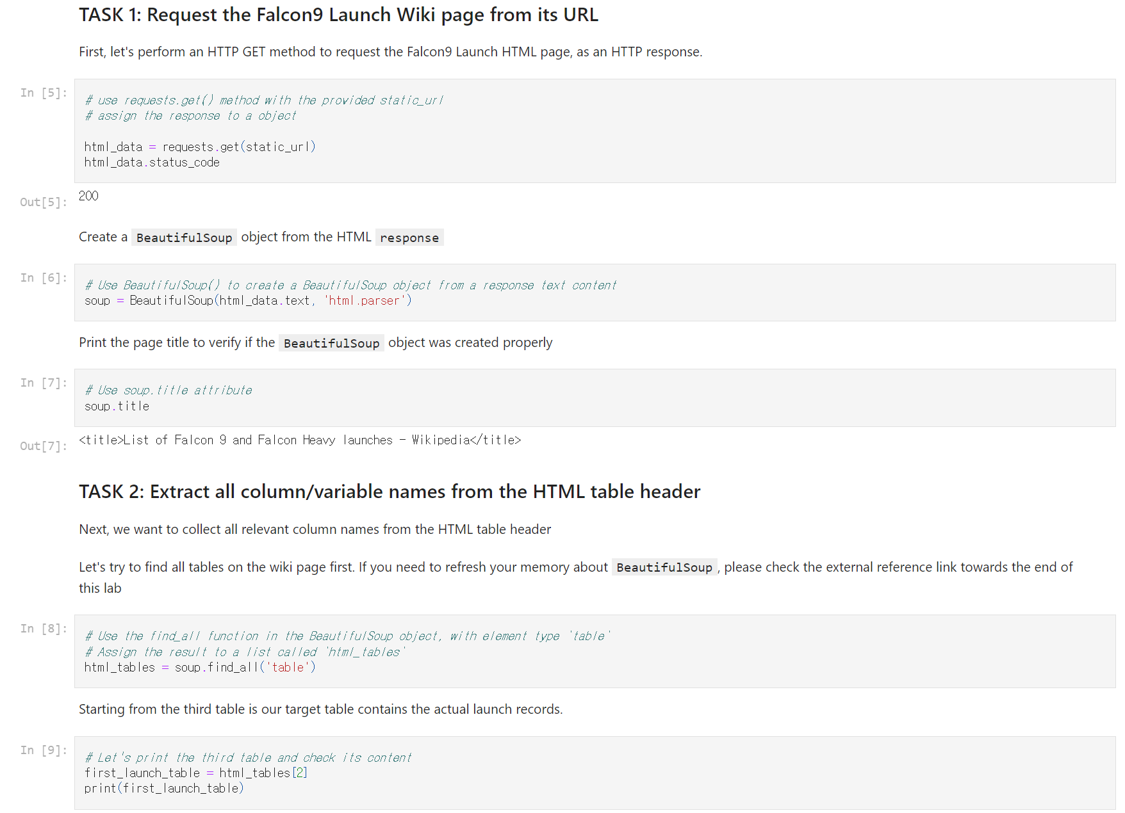
Data Collection - Scraping
Present your web scraping process using key phrases and flowcharts
Add the GitHub URL of the completed web scraping notebook, as an external reference and peer-review purpose

Slide 10

Data Wrangling
In order to perform exploratory data analysis to this project, first the training labels are needed to be determined.
Basically, which set of attributes should be used?
Used the number of launches at each particular launch site of Falcon 9 as well as the number of each orbits launch has made.
The result attribute that was desired is the landing attribute.
This result was then exported as a CSV file.
Link: https://github.com/sangwookim98/IBM_capstone/blob/main/Data_Wrangling.ipynb

Slide 11
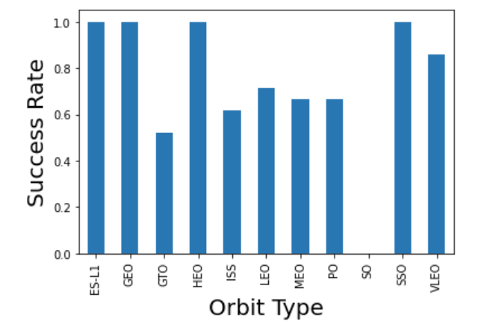
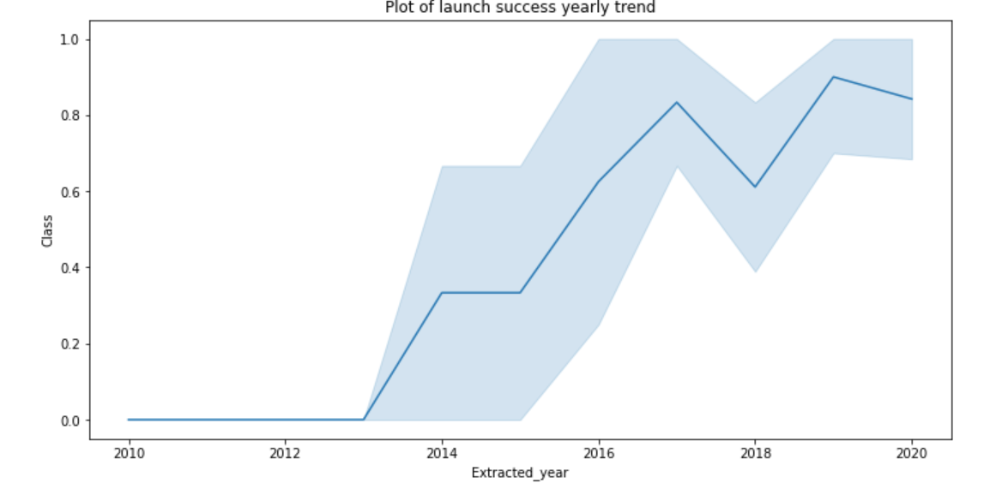
EDA with Data Visualization
Multiple plots were made in order to see which relationship between which attributes were most relevant to the goal of the final project.
Used Matplotlib to visualize the relationship between flight number and launch site, payload mass and launch site, success rate of each orbit type, flight number and orbit type, and the rate of each launch at a yearly trend.
https://github.com/sangwookim98/IBM_capstone/blob/main/EDA%20with%20Visualization.ipynb

Slide 12
EDA with SQL
We loaded the SpaceX dataset into a PostgreSQL database without leaving the Jupyter notebook.
We applied EDA with SQL to get insight from the data. We wrote queries to find out for instance:
The names of unique launch sites in the space mission.
The total payload mass carried by boosters launched by NASA (CRS)
The average payload mass carried by booster version F9 v1.1
The total number of successful and failure mission outcomes
The failed landing outcomes in drone ship, their booster version and launch site names.
Link:
https://github.com/sangwookim98/IBM_capstone/blob/main/EDA%20using%20SQL.ipynb

Slide 13
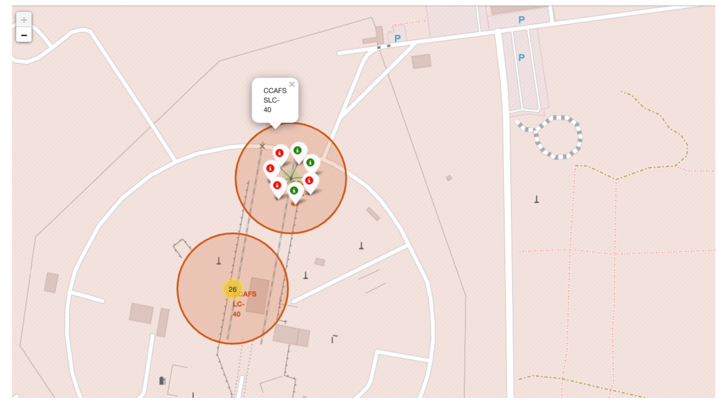
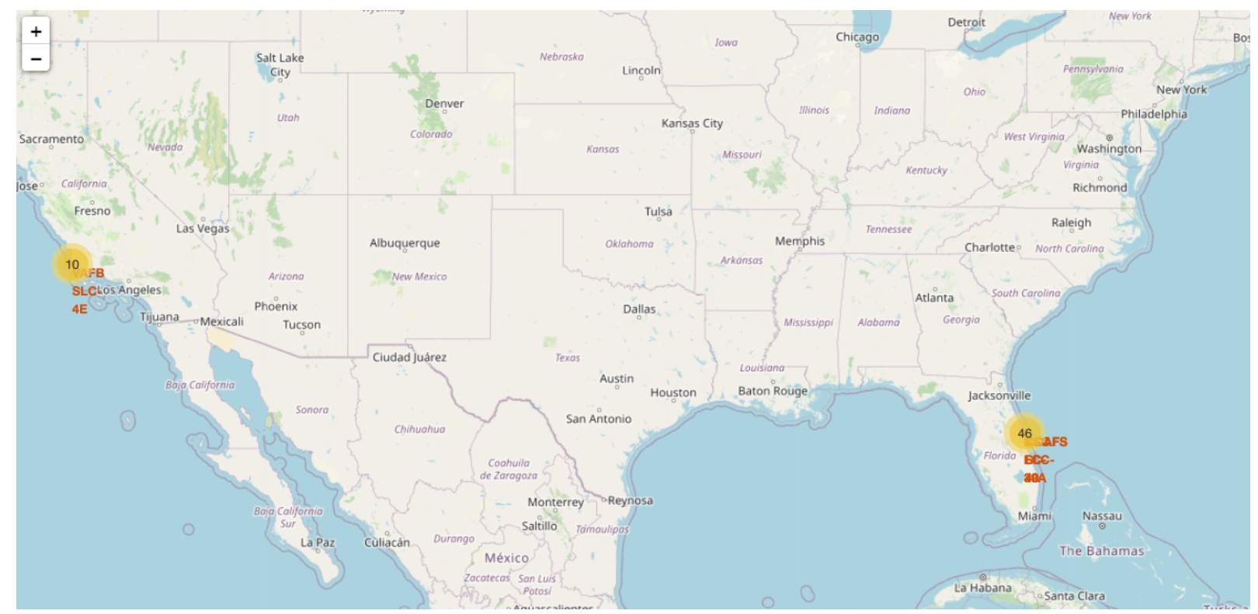
Build an Interactive Map with Folium
Marked all launch sites, and added map objects such as markers, circles, lines to mark the success or failure of launches for each site on the folium map.
Assigned the feature launch outcomes (failure or success) to class 0 and 1.i.e., 0 for failure, and 1 for success.
Using the color-labeled marker clusters, we identified which launch sites have relatively high success rate.
Calculated the distances between a launch site to its proximities. We answered some question for instance:
Are launch sites near railways, highways and coastlines.
Do launch sites keep certain distance away from cities.
Link:
https://github.com/sangwookim98/IBM_capstone/blob/main/Analysis%20using%20Folium.ipynb

Slide 14
Build a Dashboard with Plotly Dash
Pie charts were used to show the total launches at certain launch sites
Scatter graph is used to show the relationship with Outcome and Payload Mass (Kg) for the different booster version of Falcon 9
Again, the link is provided at:
https://github.com/sangwookim98/IBM_capstone

Slide 15
Predictive Analysis (Classification)
First, data is standardized before training and testing for accuracy
Employed several machine learning techniques to make predictive analysis
Logistic Regression
Support Vector Machine
Decision Tree Classifier
K Nearest Neighbors
After setting each techniques up, accuracy for each model is calculated to determine which is model results in highest accuracy.

Slide 16
Results
Exploratory data analysis results
Interactive analytics demo in screenshots
Predictive analysis results

Slide 17

Section 2

Slide 18
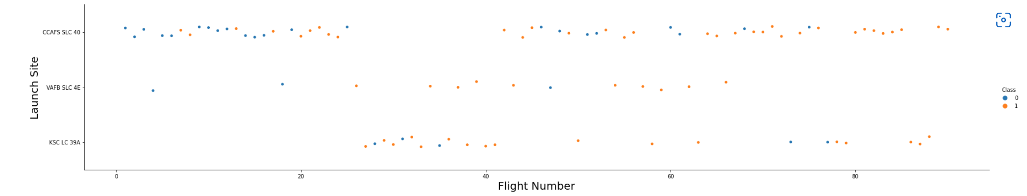
Flight Number vs. Launch Site
Based on this scatter plot, the following relationship is shown: the larger the flight number, the greater success at which the first stage of a rocket lands.

Slide 19
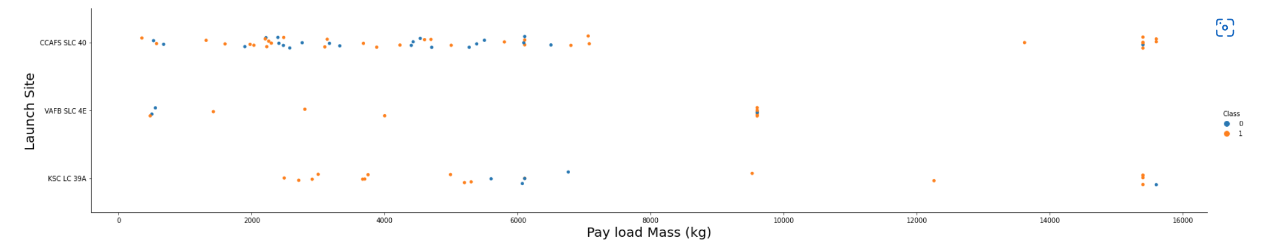
Payload vs. Launch Site
The following relationship is shown from this scatter plot: the higher the payload mass, the higher the success rate for the first stage of the rocket to land.

Slide 20
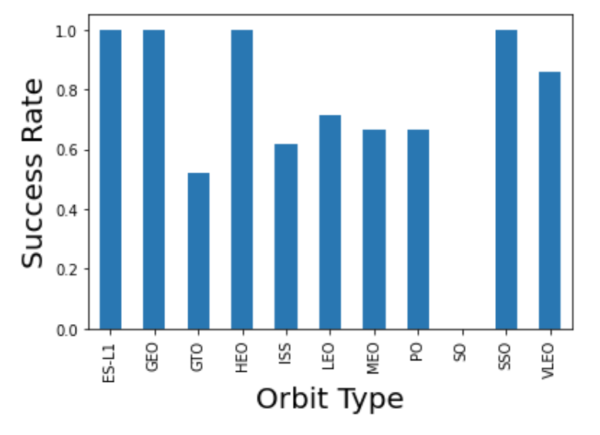
Success Rate vs. Orbit Type
The following bar graph shows that orbits ES-L1, GEO, HEO, SSO showed the highest success rate of landing.

Slide 21
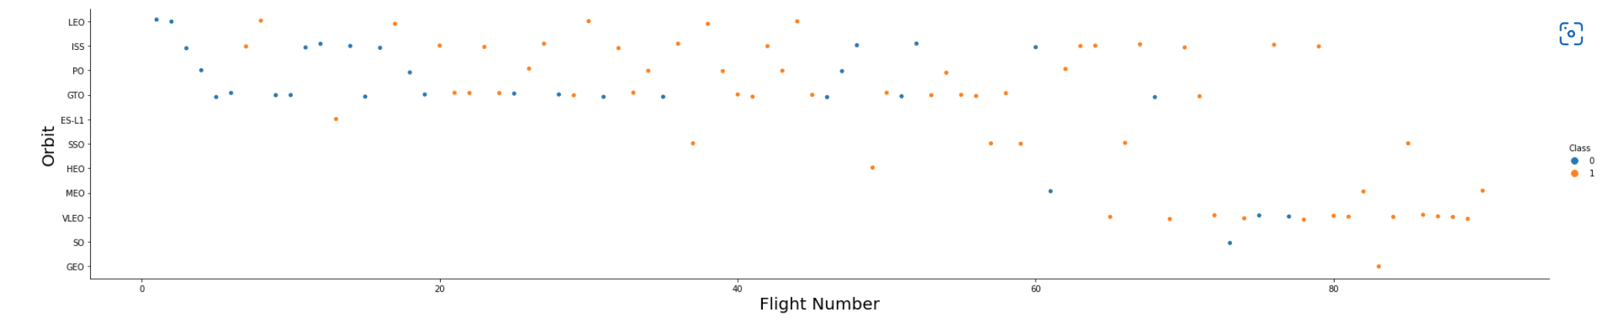
Flight Number vs. Orbit Type
The above scatter graph shows a relationship where the in the launches related to the LEO orbit, success of landing has a positive correlation with number of flights taken.
However, there seem to be no relationship showing in GTO orbit particularly.

Slide 22
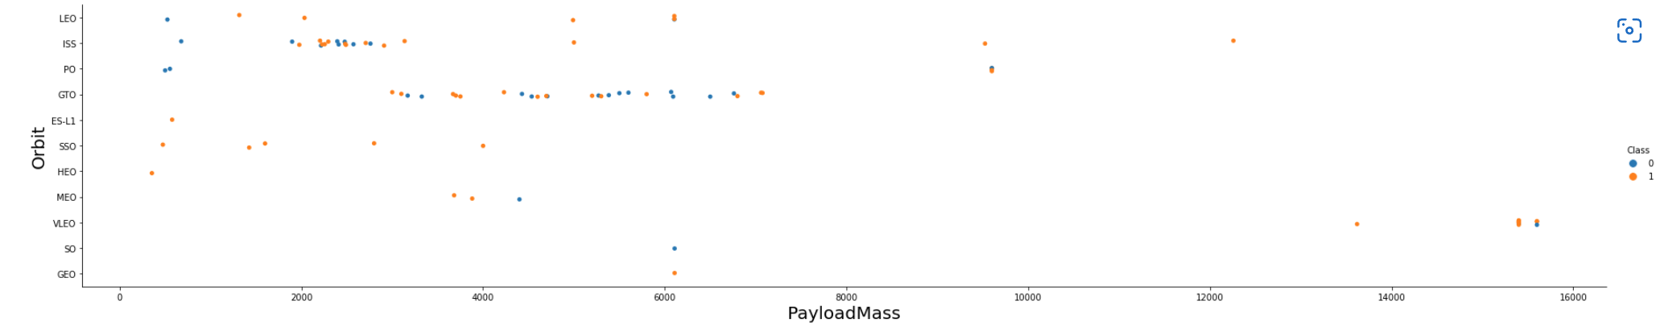
Payload vs. Orbit Type
Based on the above scatter plot, it can be observed that with heavy payloads, the successful landing are more for PO, LEO and ISS orbits.

Slide 23
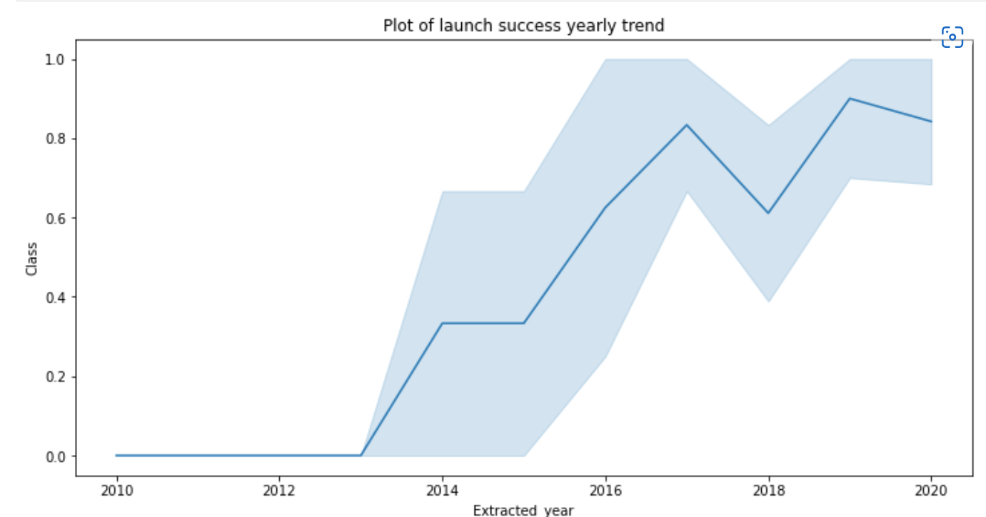
Launch Success Yearly Trend
The success rate at which the first stage of a rocket lands safely increases right after 2013

Slide 24

All Launch Site Names
Used DISTINCT to show only unique launch sites from the SpaceX data

Slide 25

Launch Site Names Begin with 'CCA'
Find 5 records where launch sites begin with `CCA`

Slide 26

Total Payload Mass
Calculate the total payload carried by boosters from NASA

Slide 27

Average Payload Mass by F9 v1.1
Calculated the average payload mass carried by booster version F9 v1.1by the following SQL code

Slide 28

First Successful Ground Landing Date
Find the dates of the first successful landing outcome on ground pad

Slide 29

Successful Drone Ship Landing with Payload between 4000 and 6000
List the names of boosters which have successfully landed on drone ship and had payload mass greater than 4000 but less than 6000
Used the WHERE clause as there were multiple conditions in which it was tasked to find

Slide 30

Total Number of Successful and Failure Mission Outcomes
Calculate the total number of successful and failure mission outcomes

Slide 31

Boosters Carried Maximum Payload
List the names of the booster which have carried the maximum payload mass

Slide 32

2015 Launch Records
List the failed landing_outcomes in drone ship, their booster versions, and launch site names for in year 2015

Slide 33

Rank Landing Outcomes Between 2010-06-04 and 2017-03-20
Selected Landing outcomes and the COUNT of landing outcomes from the data and used the WHERE clause to filter for landing outcomes BETWEEN 2010-06-04 to 2010-03-20.
Applied the GROUP BY clause to group the landing outcomes and the ORDER BY clause to order the grouped landing outcome in descending order.

Slide 34

Section 3

Slide 35

All SpaceX Launch Sites

Slide 36

Markers with Color Labels
This is a map of the Florida Launch Site
Green: successful landing
Red: failed landing

Slide 37

Distance to Landmarks from Launch Site

Slide 38

Section 4

Slide 39

Using Pie Chart to show Total Success launches

Slide 40

Success to Failure Proportions

Slide 41

Scatter plot of Heavy and Low Weighted Payload

Slide 42

Section 5

Slide 43

Classification Accuracy
Finalized which classification model has the highest accuracy suited for this project

Slide 44

Confusion Matrix
The confusion matrix for the decision tree classifier shows that the classifier can distinguish between the different classes. Although the major problem is the appearance of the false positives .i.e., unsuccessful landing, it marked it as successful landing by the classifier

Slide 45
Conclusions
Based on this:
The larger the flight amount at a launch site, the greater the success rate at a launch site.
Launch success rate started to increase in 2013 till 2020.
Orbits ES-L1, GEO, HEO, SSO, VLEO had the most success rate.
KSC LC-39A had the most successful launches of any sites.
The Decision tree classifier is the best machine learning algorithm for this task.

Slide 46


